Slide 1
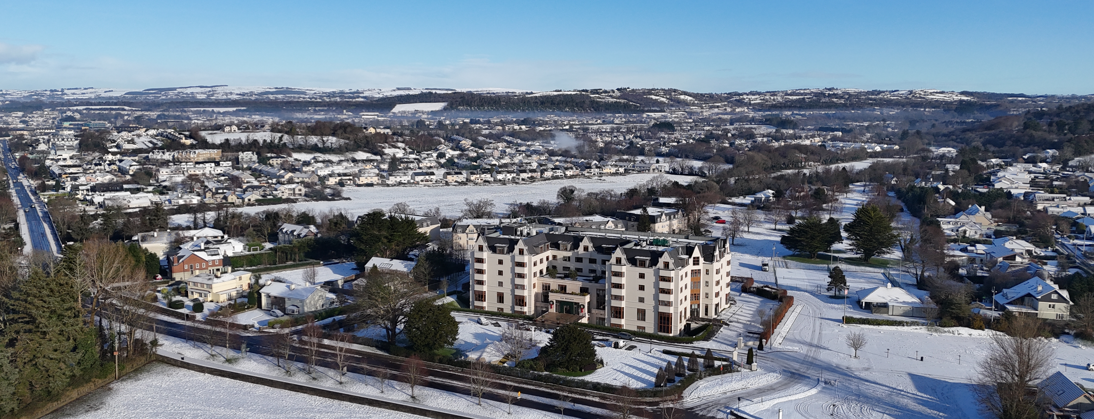


Ciaran Lynch
03/12/2025

Slide 2
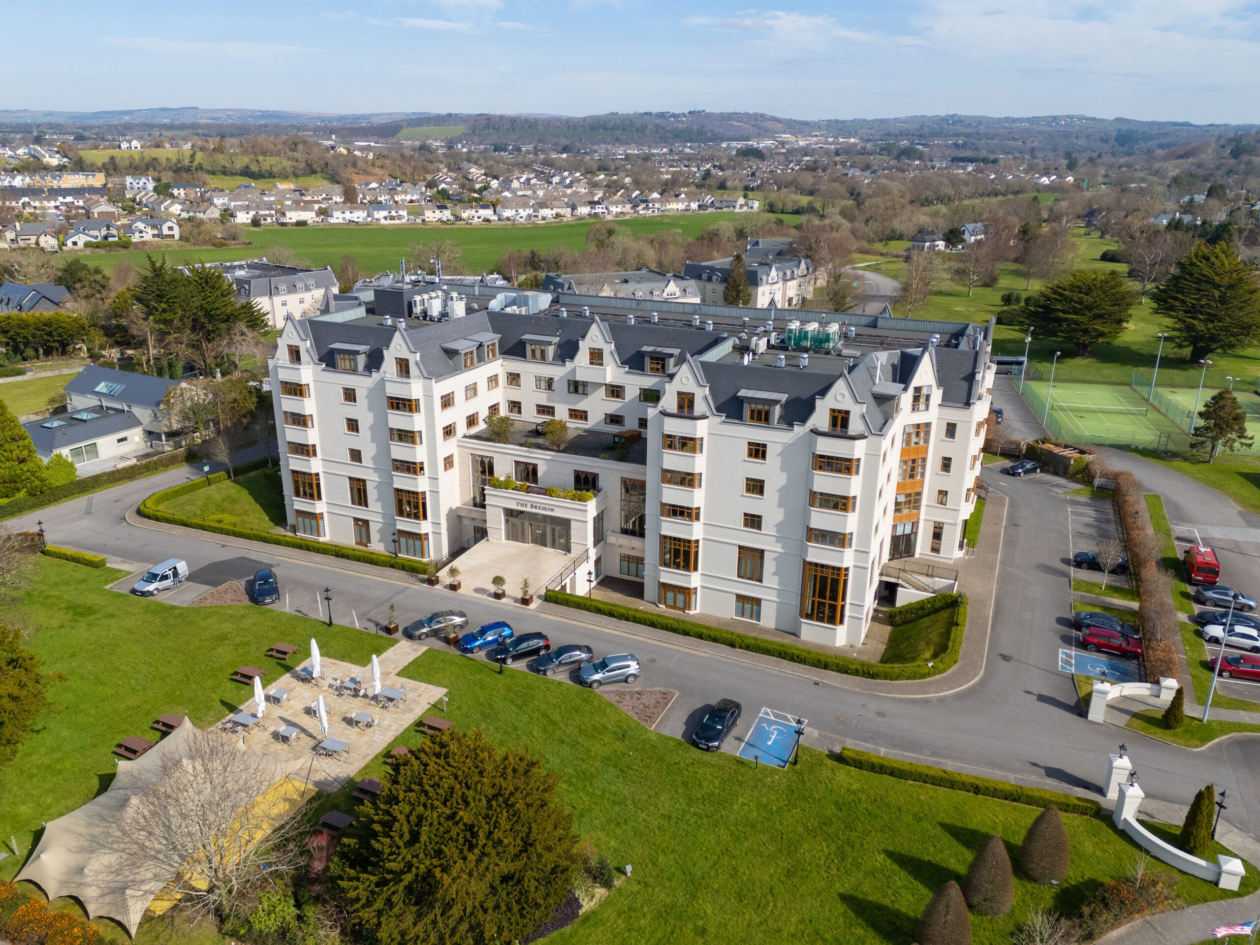
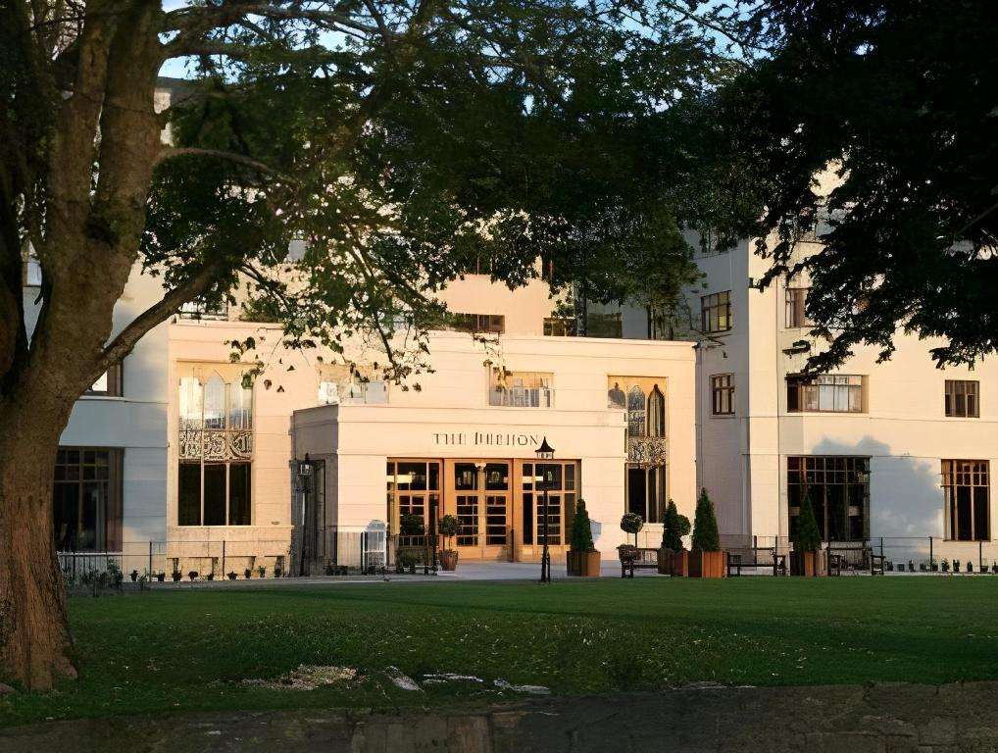
Meet the Hotel
The Brehon Hotel & Spa​​
The Brehon Hotel opened in 2004, under the management of the Gleneagle Hotel and the O’ Donoghue Family.
Following on from the opening of the Gleneagle Arena (formerly INEC) next door, the O’ Donoghues realised that there was a need for a luxury hotel to cater for the artists and guests that were performing and attending concerts in the INEC.
Inspired by tradition, in tune with today…

Slide 3
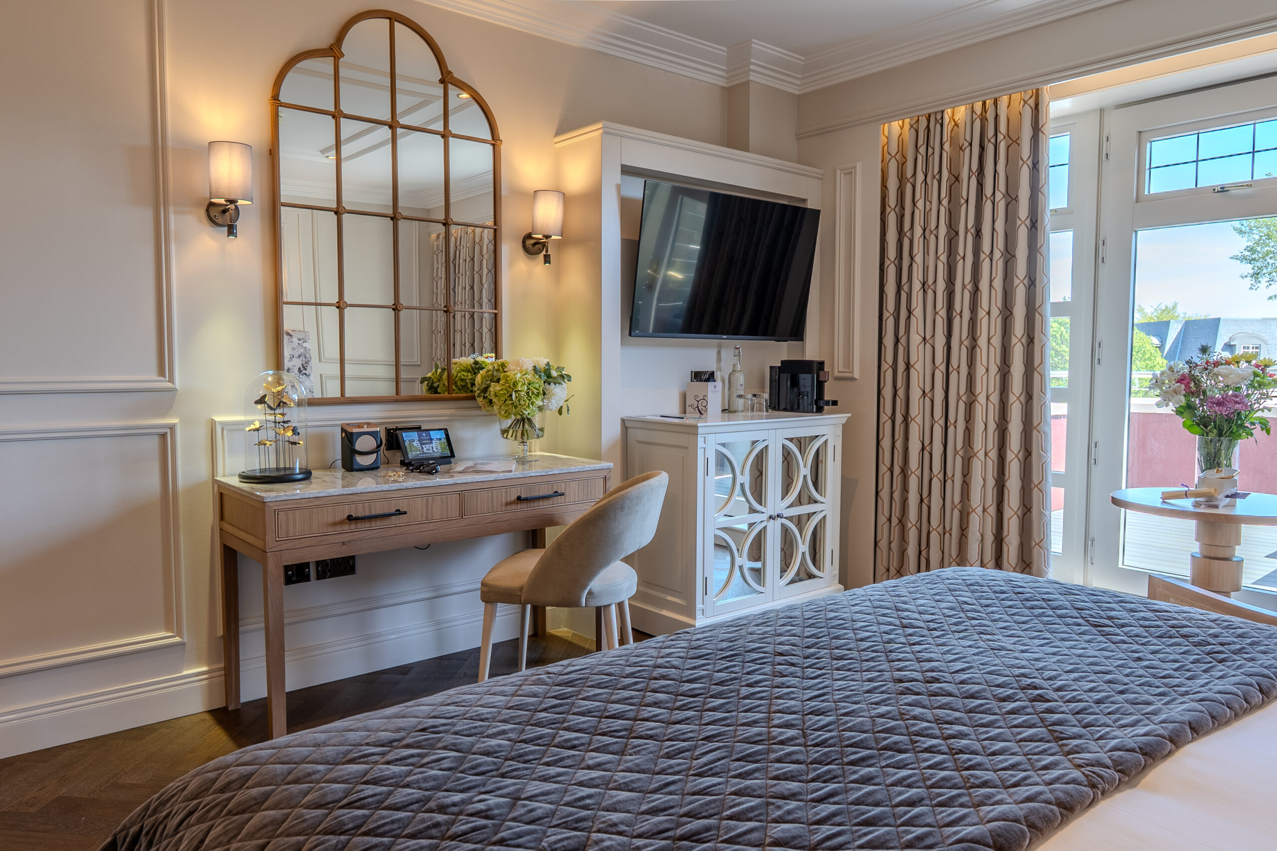
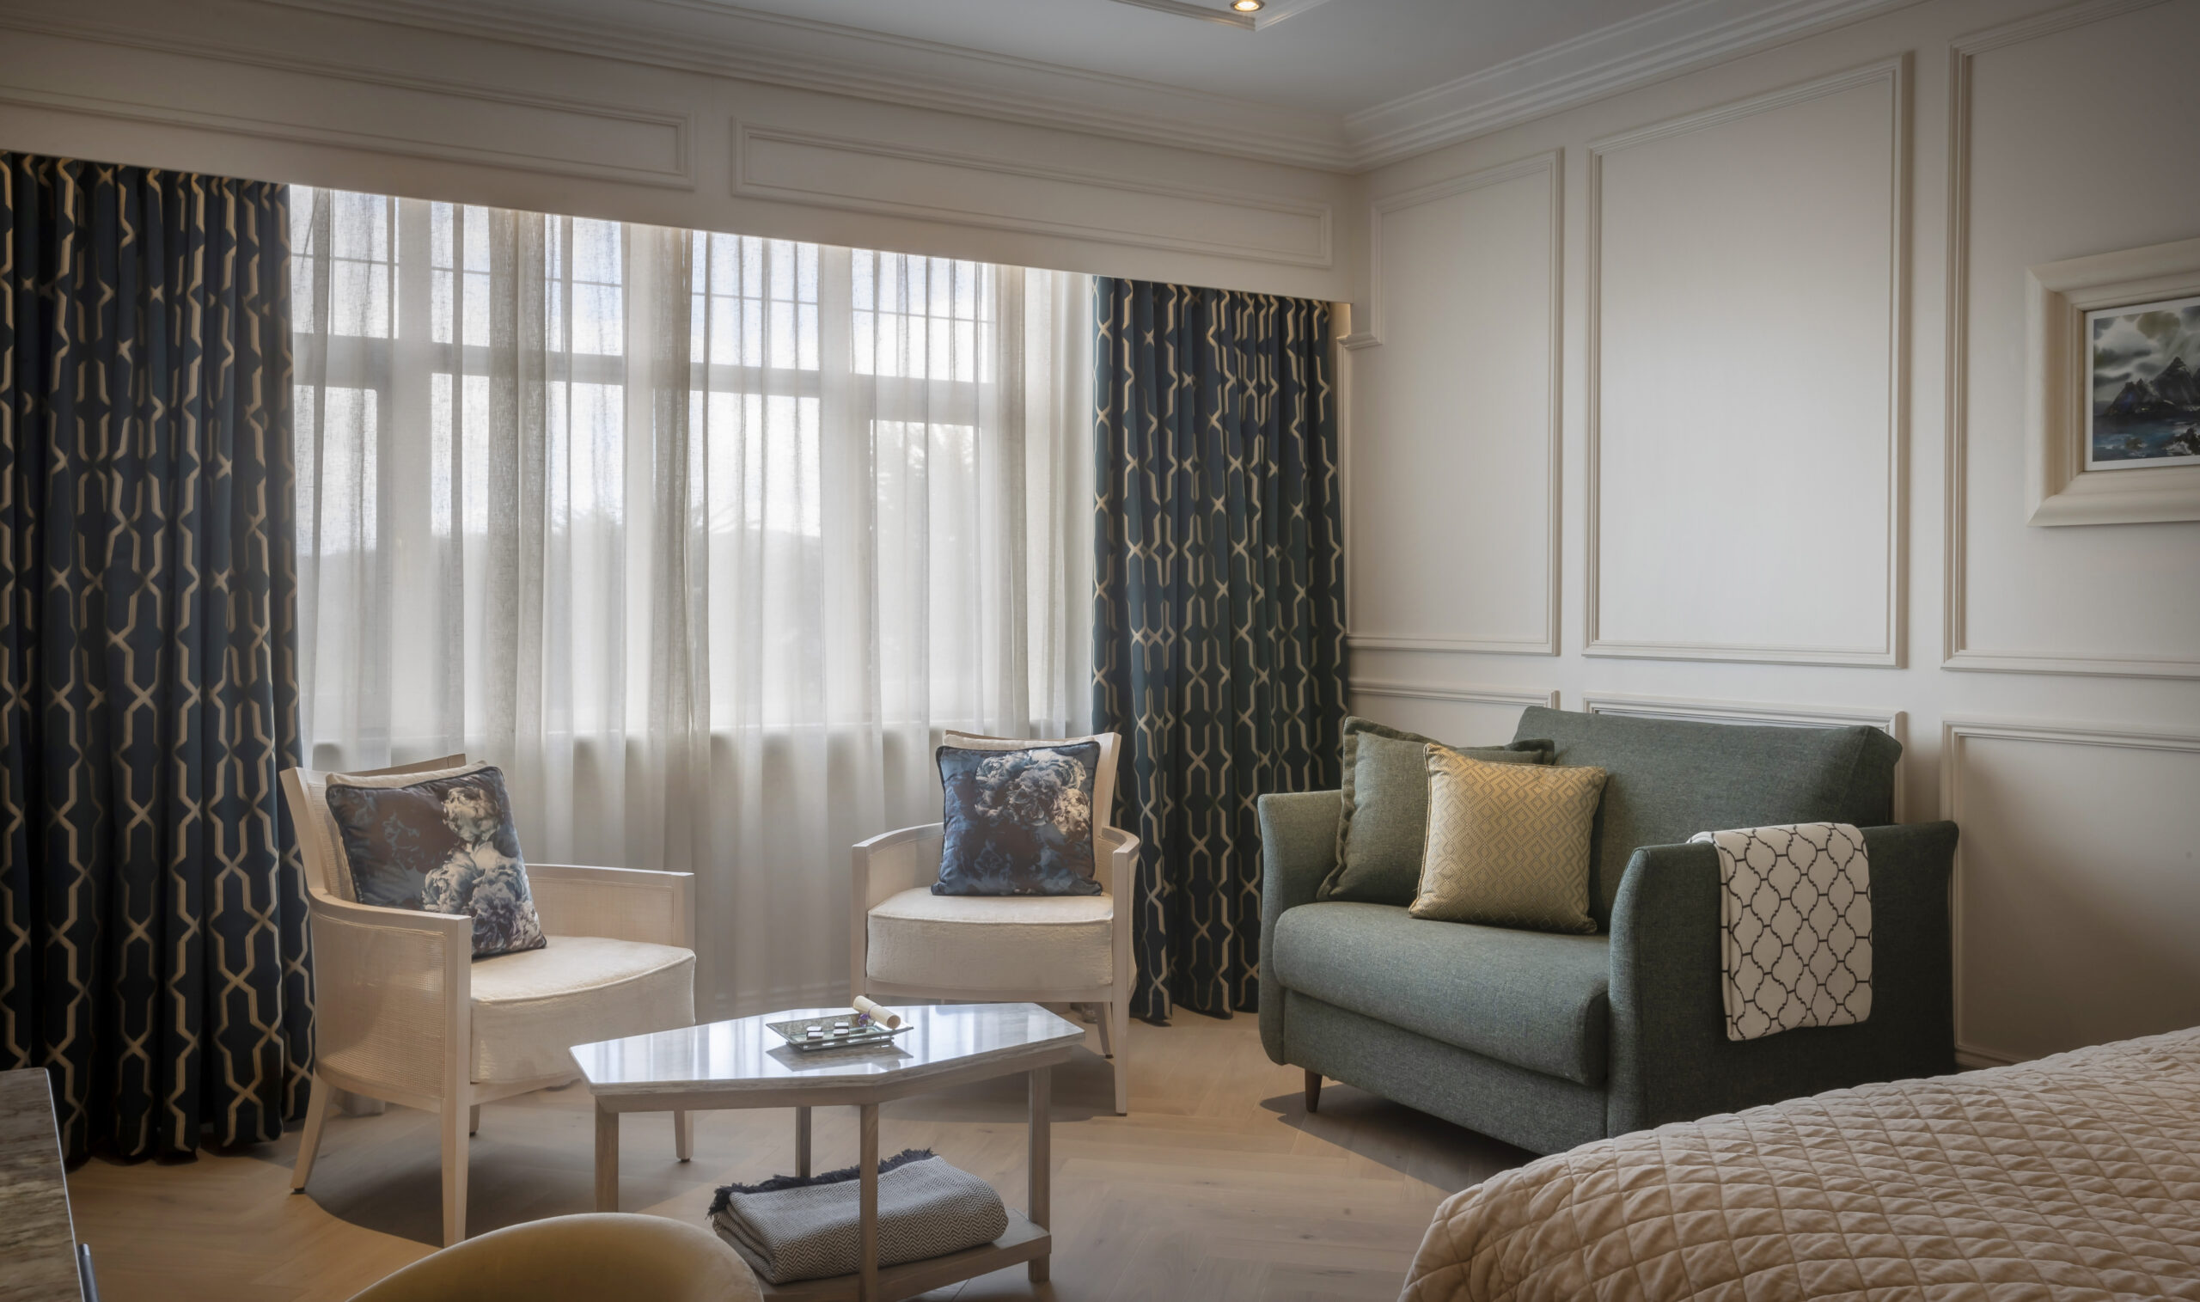
Meet the Hotel
The Brehon Hotel & Spa​​
The Brehon Hotel & Spa has 125 bedrooms.
Of these 87 have been upgraded to our new Heritage Collection standard.
The remaining rooms will be refurbished in Q4 2026 and Q1 2027.

Slide 4
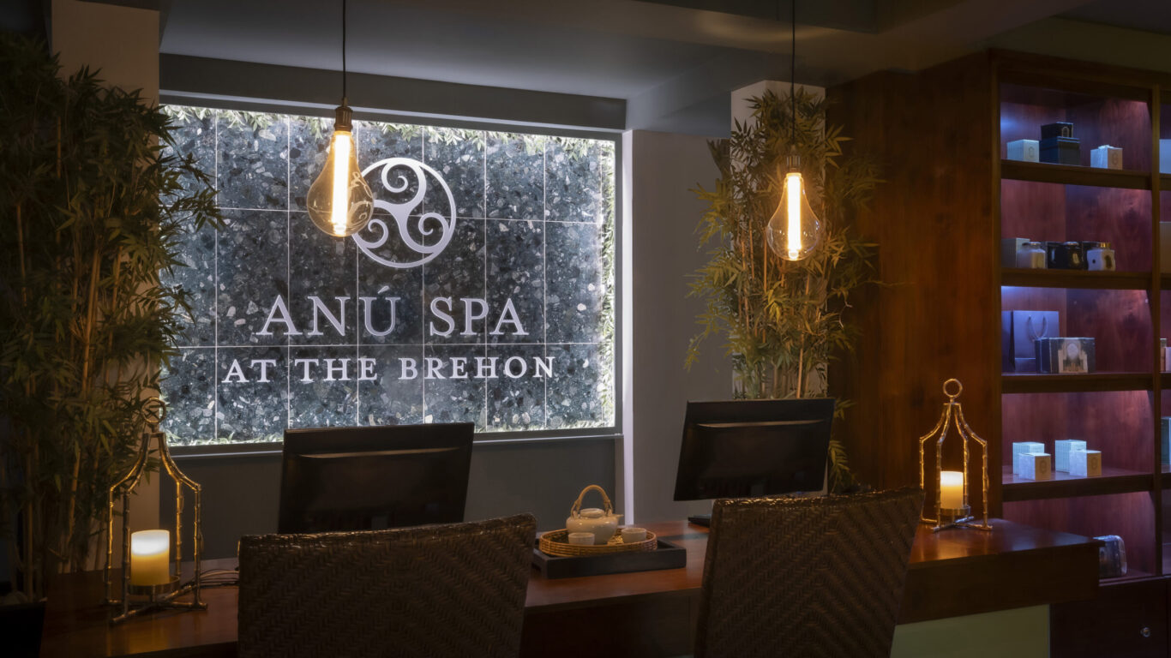
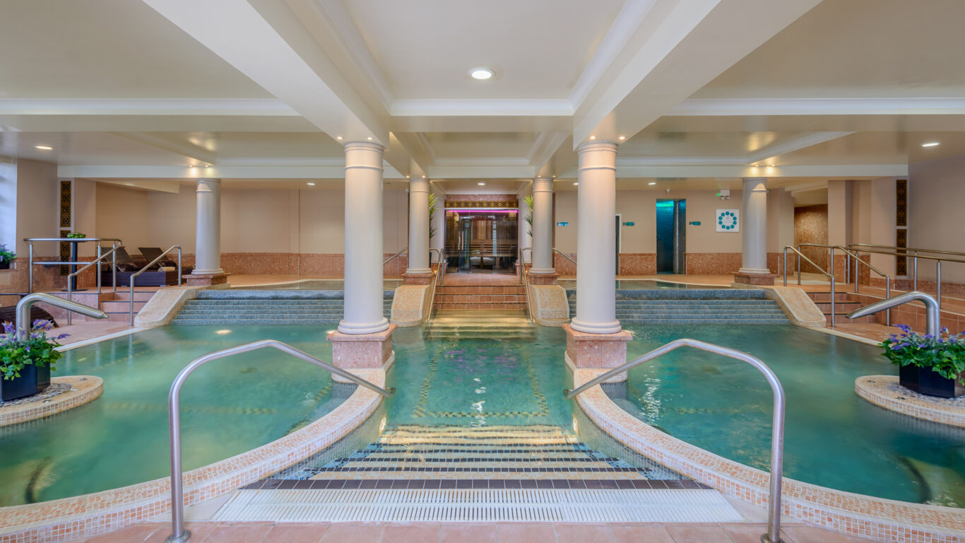
Meet the Hotel
Anú Spa @ The Brehon
Formerly the Angsana Spa, we rebranded in 2023 to the Anú Spa. Inspired by the Celtic earth goddess “Anú”
We have collaborated with local producer Liz of Íon Organics and created Signature Treatments using their products.
In October 2025, we launched a partnership with Elemis. An international supplier of award-winning skin care products

Slide 5
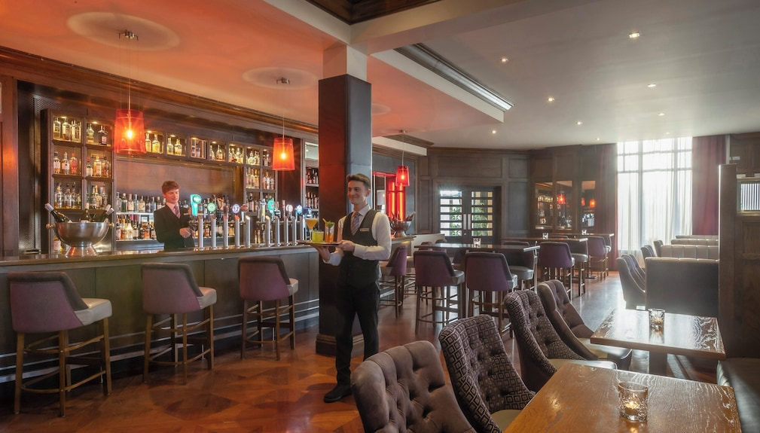
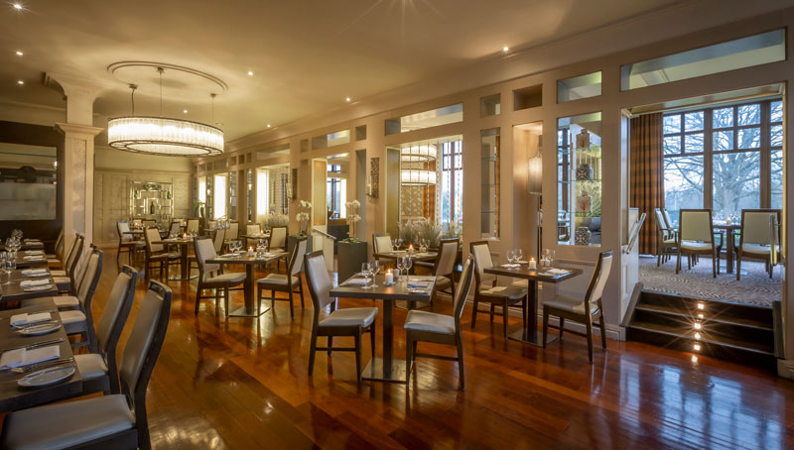
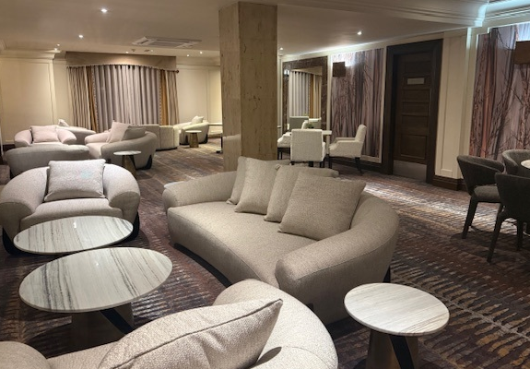
Meet the Hotel
Food & Beverage Offerings @ The Brehon
The Brehon Bar
Open daily from 10:30 and serving food until 9pm every evening. A favourite among locals, residents and concert goers.
Danú Restaurant serves breakfast and dinner each day. Also catering for special occasions in our Private Dining Room.
Afternoon Tea is served every Sunday, while our resident local pianist performs in the lobby.

Slide 6
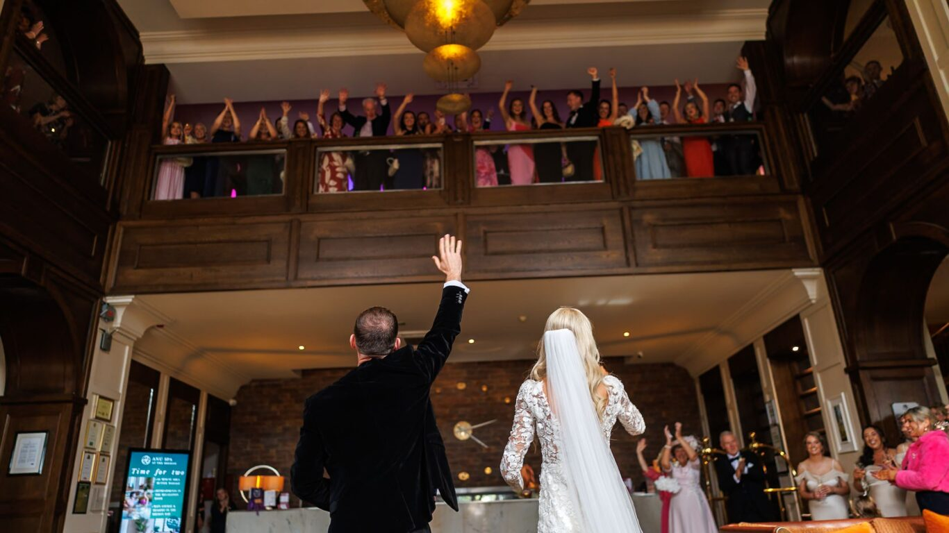
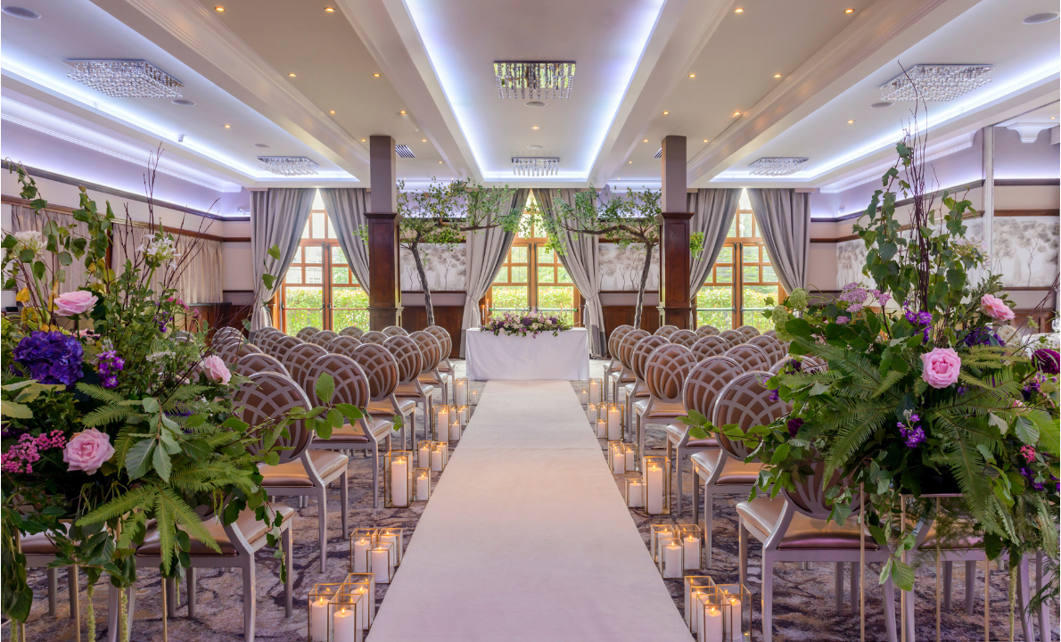
Meet the Hotel
Weddings @ The Brehon
The Brehon can host your wedding in several spaces. We can tailor our packages to suit any size wedding.
Our dedicated team are always on hand to help, advise and guide our couples with the finer details of what will be the greatest day of their lives.
The perfect wedding destination,
Say I Do… at The Brehon

Slide 7
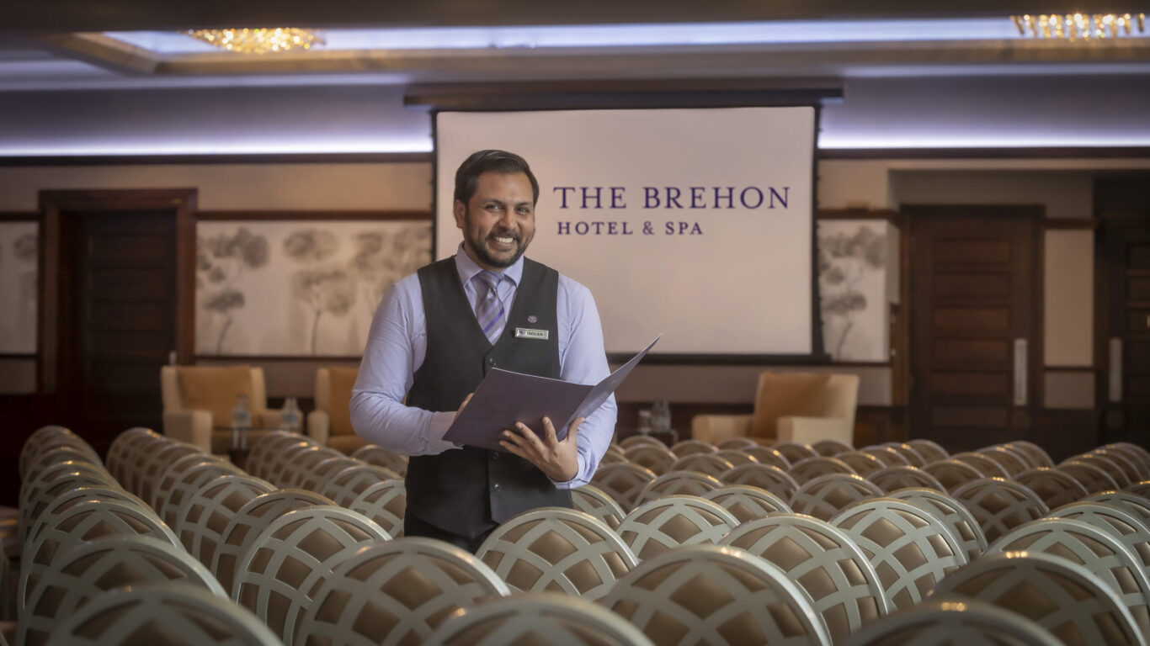
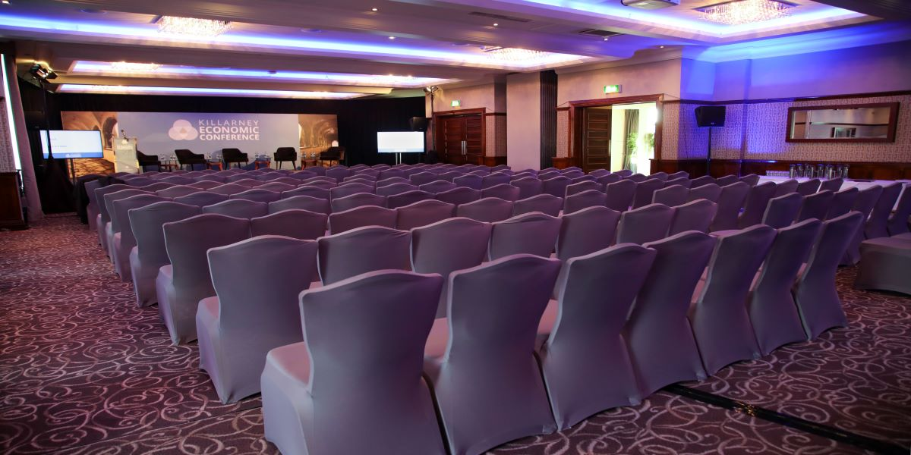
Meet the Hotel
The Brehon Means Business
The Brehon has several designated meeting spaces and can cater for up to 250 delegates in our Brehon Suite.
With break out spaces, high tech AV and lighting equipment as well as a variety of food and beverage options, The Brehon events team are always on hand to assist you in planning your next corporate day out.

Slide 8

Our Challenge
At The Brehon Hotel & Spa we are looking for a solution to integrate an intelligent chatbot into our website and integrate into internal systems. ​
The Brehon Hotel & Spa

Slide 9
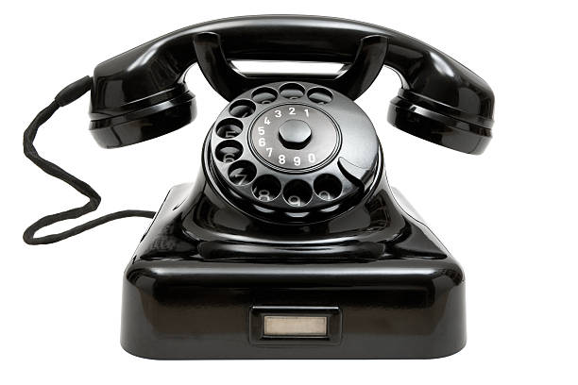



Current Situation
Reservations
We receive most communication in the forms of calls, emails and social media messages. We also receive communication via 3rd party portals; Booking.com, Expedia etc…
We communicate via the same channels, as well as Revinate our CRM.
Front Office
Weddings
Events
Marketing Department
The Brehon Hotel & Spa

Slide 10
Current Situation
Do you have availability?
What types of rooms?
What are the rates?
A lot of the communication that we receive, and the responses are very generic and repetitive.
What time is breakfast?
What time is check in?
What time is check out?
What time is the bar open?
What time is dinner?
What is the best way to get to the hotel?
Do you offer a shuttle bus?
Can I get a number for a taxi?
What is there to do when it is raining?
How far away is Killarney town?
The Brehon Hotel & Spa

Slide 11
Current Situation
Check guests in
Check guests out
Deal with all face-to-face enquiries
Deal with all billing queries
Answer calls and divert where necessary
Reply to emails
Reply to messages on booking.com
Reply to messages on Expedia
Do pre-arrival calls
Book dinners, add extra amenities
Allocate bedrooms
And much, much more….
Our Front Office & Reservations Teams
Our Reception is staffed 16 hours a day.
Enquiries that come in between 11pm and 7am, wait until the morning for responses
The Brehon Hotel & Spa

Slide 12

What we would like to achieve… Chatbot Requirements
We would like a chatbot that will:
sit on our website and some social media channels.
Capable of translating 2-way communication into at least the top 5 languages, ideally more.
Able to pull live data from our website and booking engines, show availability and rates for bedrooms, spa, dining etc…
Integrate into our PMS system to input bookings, update notes etc..
Enhance guest experience and engagement with fast, accurate, and personalized support
Improve operational efficiency by reducing manual workload for staff.

Slide 13
What we would like to achieve… Chatbot Requirements
Answer questions in relation to all aspects of the hotel and the area.
Handle 85%+ of communication before seamlessly transferring to a live hotel agent.
“Digital Concierge” that can assist guests before, during and after their stay, via WhatsApp or similar.
Must have an authentic voice and never frustrate the end users.
Streamline some communication channels to reduce the number of portals required.
Emails, 3rd party, new chatbot portal should ideally all sit within the same portal.
SMS/Whatsapp capability – without prohibitive costs.

Slide 14

Ensuring that we pick the correct solution for our needs.
Many solutions are very similar; however, some are a bit stronger in one area or another.
Pricing can be a factor, particularly when integration and set up costs are calculated. WhatsApp costs may be extra again.
One company was just launching into the Irish market, so no real examples to reach out to.
Putting them side by side it was difficult to see what would be the best fit for us.
I have seen some hotels remove chatbots from their sites recently.
I do not want to be in a situation where we spend weeks planning, training, implementing and we do not see real benefit for our guests or our staff.

Slide 15
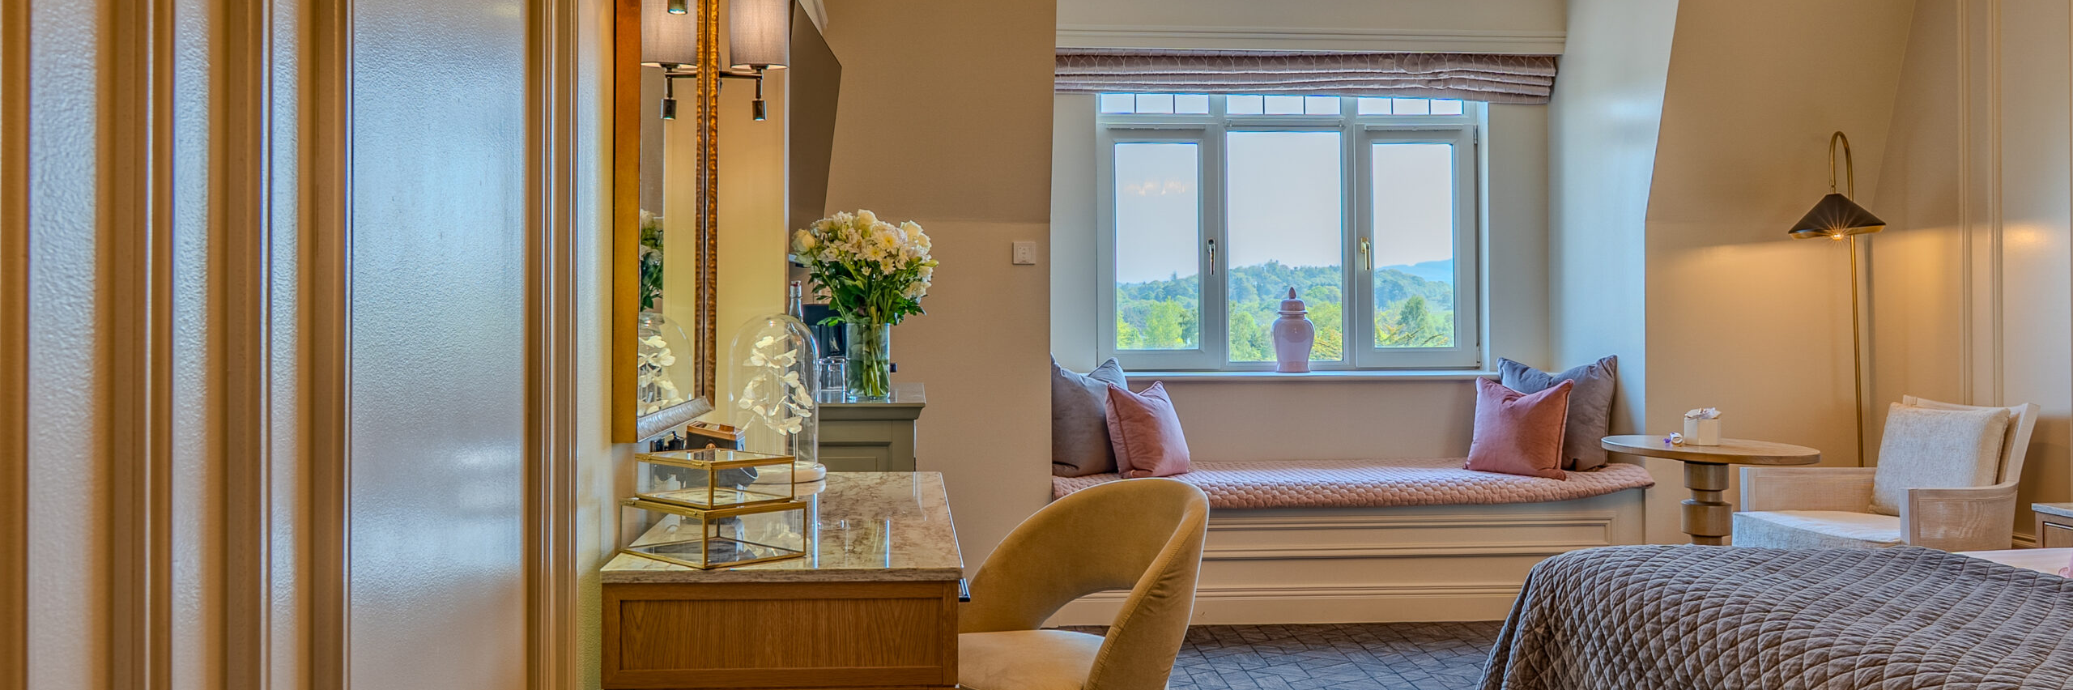
Concerns and pitfalls we would like to avoid…

Slide 16

Concerns for Guests
We cannot have guests struggle to communicate with the chatbot.
It cannot turn people away from our website in frustration.
It must have coherent language and be able to handle more than one element of a question at a time.
Must be multi-lingual.

Slide 17
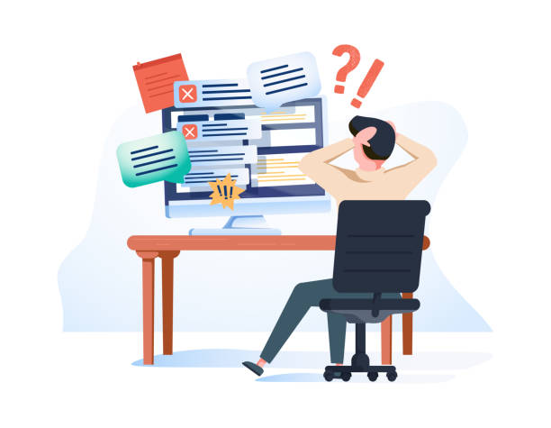
Concerns for Staff
Staff need to buy into what we are doing and why we are doing it. Training/onboarding will be essential
It must make sense for them in their day-to-day jobs
It must make things easier.
We do not want to add another system or process unless it will simplify and streamline our front desk communications

Slide 18

“The best technology doesn’t replace hospitality — it enhances it.”
Our goal is a digital experience that reflects the warmth, care, and effortless luxury our guests have come to expect from The Brehon Hotel.

