Slide 1

John McGovern
CEO

Slide 2
Who we are
We have set out to revolutionise domiciliary care, making it more personal, efficient, and technology-assisted for aging adults and their families.
We recognised the growing need for comprehensive home care services, especially in the face of an aging population.
Our mission is clear: to elevate the standards of home care, allowing individuals to continue enjoying life from the comfort of their own homes.
Platinum Homecare isn’t just about maintaining independence and happiness, it is our client-centric approach, ensuring that your loved ones receive the attention and care they deserve, which, in turn, will give you peace of mind.
We’re committed to fundamentally changing the home care model, focusing on effectiveness, personalisation, and the integration of cutting-edge technology. We’re proud to be at the forefront of this evolution, setting a new standard for compassionate and effective home care services.

Slide 3
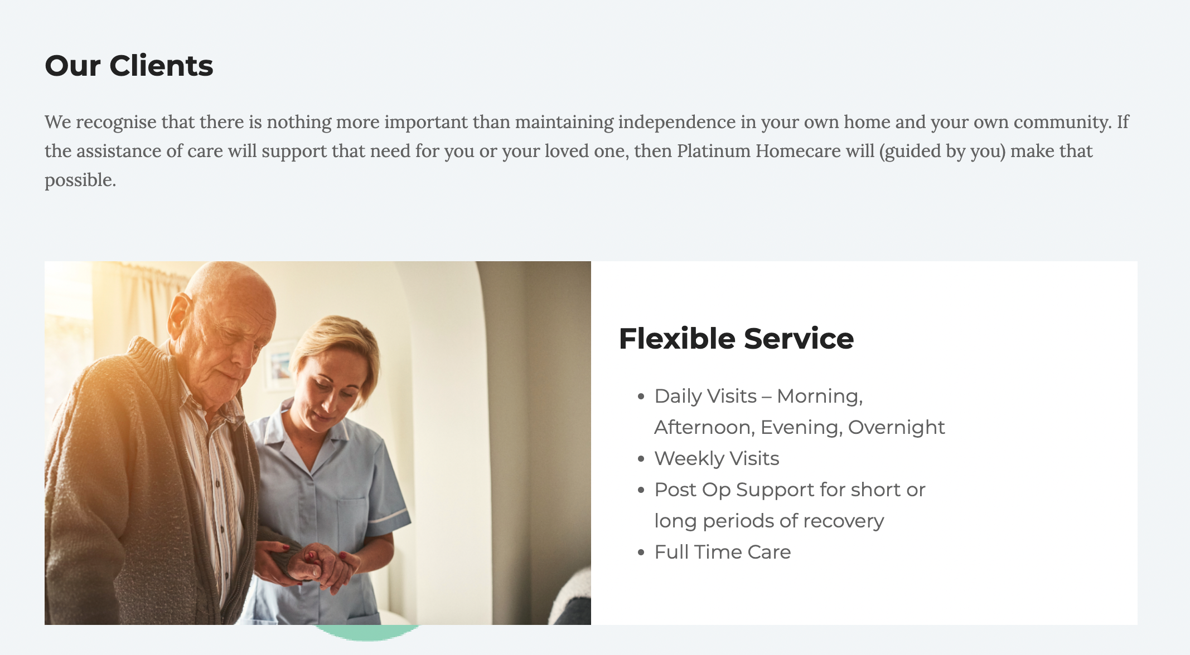
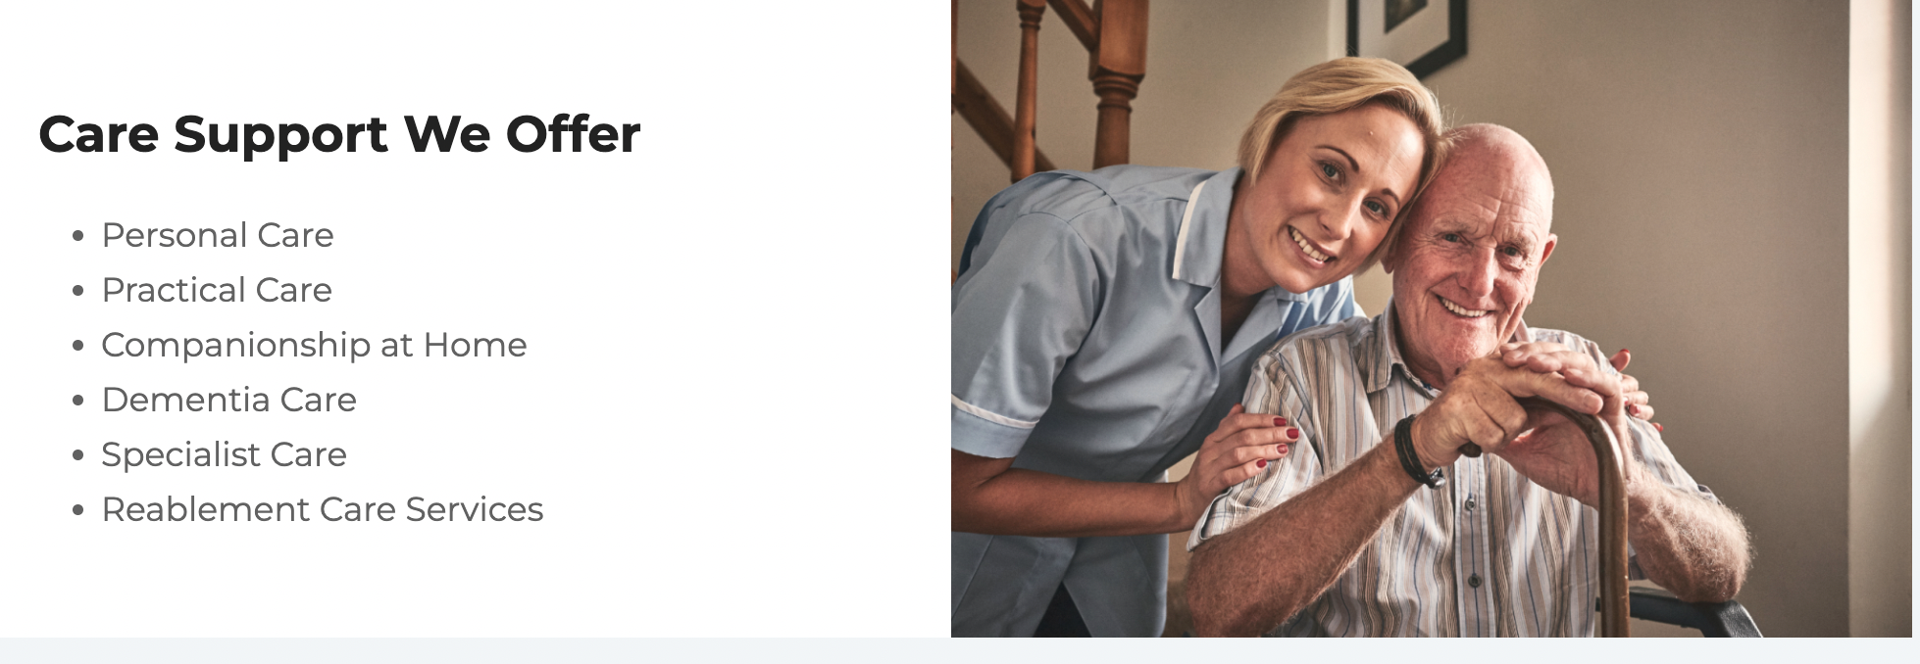

Slide 4
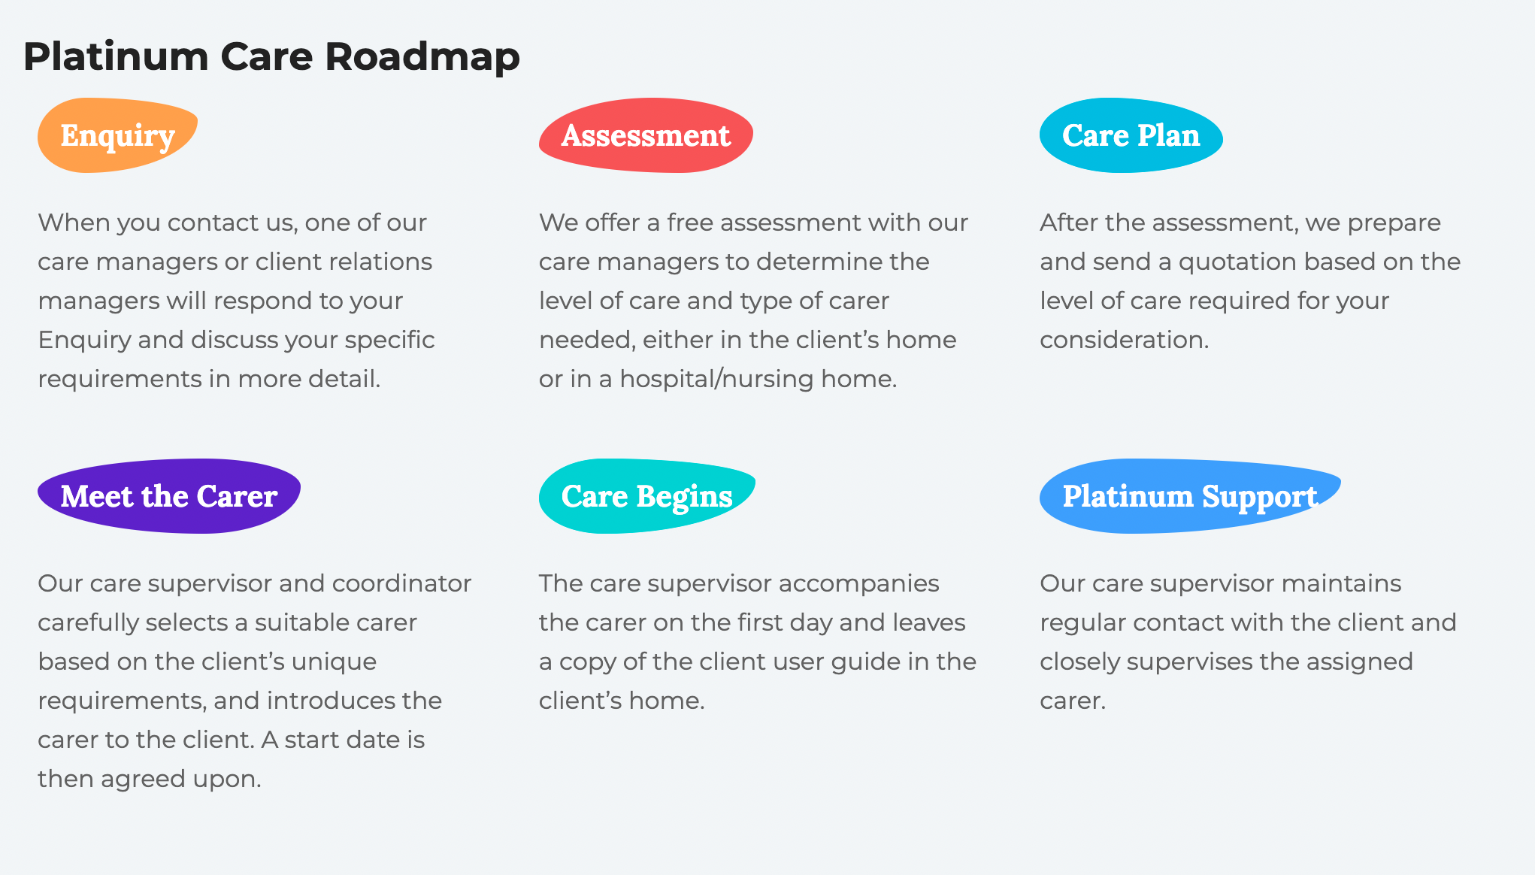

Slide 5
Scheduling Management Challenge
Platinum Homecare is a paperless office
Manages 35,000 house visits per month
Scheduling system – One Touch
One Touch manages scheduling, rostering, digital time sheets with in app messaging
Heavy reliance on manual intervention to fix scheduling issues
As the business grows reliance on manual schedulers needs to be reduced and replaced with automated processes.
The challenge is to automate existing manual scheduling interventions

