Slide 1

VIDEO ABOUT HANLEY ENERGY
LINDA ENNIS
LEARNING & DEVELOPMENT PARTNER

Slide 2
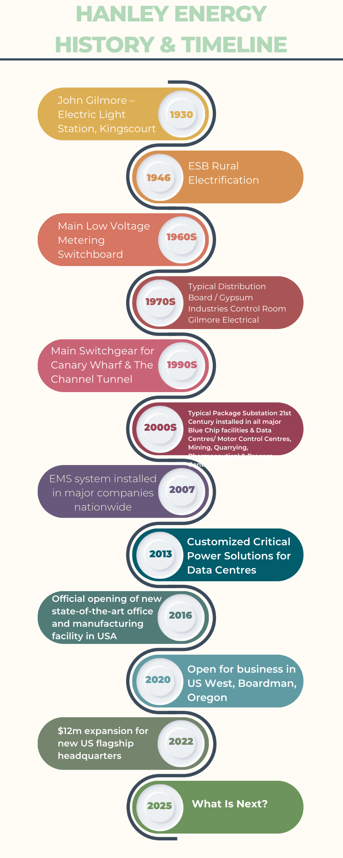

Slide 3
Apprenticeship Programme & Process
The apprenticeship programme consists of 7 phases which must be completed in approx.
4 years (208 Weeks),
The phases are split as follows: In Company - Phases 1,3,5,7 In College – Phases 2, 4 & 6
Phases
Induction 2 hours online and then with ETB College/Manager Company
Phase 1 In House (used to take 6-9 mths now up to 18 mths due to backlog from covid)
Phase 2 college 6 months
Phase 3 In Company commences on return from college
(but can't register them as phase 3 until 6 mths after they return from college – this is same at each following phase)
Phase 4 college 11-12 weeks
Phase 5 in house
Phase 6 college 11-12 weeks
Phase 7 in house
Apprenticeship tracker - This is an Excel Sheet which tracks the apprentice's journey,
the SOLAS AOL Portal is another method to access info on all apprentices and their phases.
Process Recruitment - Operations add New Apprentices to Starter/Finishers Smart Sheet –
HR pick up new recruit's names and add New Apprentices to Apprentices Tracking Sheet –
HR need check this weekly
LE

Slide 4

New Apprentices
Submit Registration
Complete Company Section of form and send forms and appendices to ETB Contact to register apprentices with SOLAS (must be done within 2 weeks of start date).
Apprentice registration takes approx.1 week to show up on SOLAS AOL
HR check AOL to see Registration Date of Apprentice add this date to tracker sheet as wages will increase by year from this date
Complete Forms
Request Information
Once information received, HR ensure all sections are completed by apprentice.
HR request Registration Form, Optician Vision Test, Signed Photos & Leaving Cert Results (or change of employer form with finish date correct as this will show up on SOLAS AOL) from apprentices on DAY they join via a Template Signature saved in Outlook.

Slide 5





Induction
Monthly Schedule
ETB CONTACT does monthly online induction for apprentices
Code of Practice
Induction covers code of practice for apprentices
Training Materials
They send the invitation to the apprentice with their Training Manual

Slide 6






Phase 1 In House
Duration
Used to take 6-9 mths to be called for Phase 2 college now up to 18 mths due to backlog from covid
Completion
When phase 1 completed apprentice, and their manager send signed paperwork by email to HR
Documentation
HR save this in apprentices file and forward this paperwork to ETB Contact, then SOLAS AOL updated. HR need to update tracker.
Important Note
Paperwork must be sent to ETB Contact by email before they attend the next college Phase

Slide 7




Phase 2 College
College Invitation
Any ETB nationally may invite the apprentice to college phase 2. There are no college fees and Phase 2 calls are year round.
College call letter is received by post, we have one week from the date on the letter to accept the apprentice's place
HR scan college call letter, rename file and save into apprentice's file
Approval Process
HR forward college call to apprentice's manager to seek approval for them to be released for college
Manager speaks to apprentice and approves college call by emailing HR
HR inform college that the apprentice will take the place
Administration
HR put dates and name of college into tracking sheet
HR notify payroll of apprentice name and college dates of attendance
Apprentice will not be paid by company during college (as the ETB pay the apprentices during those dates)
Progress Tracking
During Phase 2 college will send out progress reports by post
Phase 2 results will be posted out
If resits needed, dates will be provided and must be emailed to apprentice and their manager
Each stage must be noted as a comment in the phase 2 box on the tracker sheet
Once all phase 2 is passed and completed this box on the apprentice tracker goes green

Slide 8








Phase 3 In House
Timeline
Documentation
Completed approximately 6 months after the apprentice returns from college
When phase 3 completed apprentice and their manager/assessor send signed paperwork by email to HR
System Update
Filing
HR update tracker sheet and SOLAS AOL updated with completion information
HR save this in apprentices file and forward this paperwork to ETB Contact
Paperwork must be sent to ETB Contact by email before they attend the next college Phase.

Slide 9
Phase 4 College
College Invitation
Phase 4 called to college is in Jan/Apr and Sept. Any ETB nationally may invite the apprentice to college phase 4, college call letter is received by post,
scanned and saved to apprentice file by HR
Approval Process
HR forward college call to apprentice's manager to seek approval for release, then HR notify the college of acceptance.
Financial Arrangements
HR notify payroll as apprentice will not be paid during these dates
College Fees
Apprentice must collect a sponsorship form from the college, HR will sign and approve, college send invoice to HR, HR forward on to accounts to be paid.
Duration: 11-12 weeks in college. During Phase 4 college will send out progress reports by post, these need to be scanned, renamed and filed in apprentice file, emailed to their manager and noted in tracking sheet as done. Phase 4 results will be posted out these need to be scanned, renamed, filed in apprentice file, emailed to manager and noted in tracking sheet. If in phase 4 results there is a need for resits dates of resits will be provided these must be emailed to apprentice and their manager, the apprentice organises resits themselves. Each stage of the above must be noted as a comment in the phase 4 box on the tracker sheet. Once all phase 4 is passed and completed this box on the apprentice tracker goes green.
It is important to check invoice has been both received and paid as if it has not been done it will prevent the apprentice accessing their exam results as the college hold results until payments made.

Slide 10





Phase 5 In House
Timeline
Completed approximately 6 months after the apprentice returns from college
Documentation
When phase 5 completed apprentice, and their manager/assessor send
signed paperwork by email to HR
Filing
HR save this in apprentices file and forward this paperwork to ETB Contact
System Update
HR update tracker sheet and SOLAS AOL automatically updated with
completion information
Important Note
Paperwork must be sent to ETB Contact by email before they
attend the next college Phase

Slide 11
Phase 6 College
College Invitation
Phase 4 called to college is in Jan/Apr and Sept. Any ETB nationally may invite the apprentice to college phase 6, college call letter is received by post,
scanned and saved to apprentice file by HR
Approval Process
HR forward college call to apprentice's manager to seek approval for release, then HR notify the college of acceptance.
Financial Arrangements
HR notify payroll as apprentice will not be paid during these dates
College Fees
Apprentice must collect a sponsorship form from the college, HR will sign and approve, college send invoice to HR, HR forward on to accounts to be paid.
Duration: 11-12 weeks in college. During Phase 6 college will send out progress reports by post, these need to be scanned, renamed and filed in apprentice file, emailed to their manager and noted in tracking sheet as done. Phase 6 results will be posted out these need to be scanned, renamed, filed in apprentice file, emailed to manager and noted in tracking sheet. If in phase 6 results there is a need for resits dates of resits will be provided these must be emailed to apprentice and their manager, the apprentice organises resits themselves. Each stage of the above must be noted as a comment in the phase 6 box on the tracker sheet. Once all phase 4 is passed and completed this box on the apprentice tracker goes green.
It is important to check invoice has been both received and paid as if it has not been done it will prevent the apprentice accessing their exam results as the college hold results until payments made.

Slide 12








Phase 7 In House
Completion
Final phase of apprenticeship journey
Documentation
Paperwork submitted to HR and ETB Contact
Certification
SOLAS sends letter of completion and then Craft Cert
Employment Decision
Manager decides on full-time electrician offer
When phase 1 completed apprentice, and their assessor/manager send signed paperwork by email to HR who save this in apprentices file and
forward to ETB Contact, then SOLAS AOL updated. Solas send out a letter of completion by post to company. HR scan this letter, save in
apprentices file and email to their manager requesting if they wish to offer a full-time electrician position to the person.
We have 1 month from the date on the letter in which to offer them a full-time electrician contract.
When manager confirms they would like to make the employment offer, HR save this email on file, send to HR Ops to save and put in
a contract request on smartsheets. Contracts must be back dated to the date on this letter. If the manager does not want to offer the
person a full-time contract, let HR Operations know. ETB Contact will deliver the persons craft card/cert and HR give this in person
to the electrician or post by registered post.

Slide 13
Notes on College Calls and Exams
College Calls
College Exams
No Annual Leave is permitted whilst apprentices attend college
Passed – Save in Apprentices File
Failed – Save in Apprentices File, contact apprentice inform them they are required to organise repeats directly with college and pay themselves, and inform their manager and advise apprentice to get grinds
When requesting approval from apprentice's manager keep in mind that we cannot turn down the apprentice's place
Sometimes the college call can be too far away from their home, and they do not want to go
Failed 3 Times: they will go into holding and HR Ops must be made aware
We encourage them to accept this place, as they can only turn down 3 places throughout their apprenticeship, or they go into holding

Slide 14
Apprentices Pay and Tracking
4
7
3
Years
Phases
College Phases
Total apprenticeship duration
Total program phases
Phases completed at college
Apprentices Pay - Increases yearly based on their registration date. This is NOT the date they join the company it is their REG DATE. Once Registration Forms and Appendices are sent to ETB Contact then approx. 1-week later registration is confirmed, must sign into AOL to see date of registration. The rates can change, and we get the information from connect trade union.
Moving Up Phases and Pay (check notes on phases at top of page) - Beginning of each month: check which apprentices are due an increase, email AnneMarie with their name, reg date and the year they are now on. Anne Marie will inform payroll. HE Pay whilst in company, Solas whilst in college.
Tracker: Move apprentices through the phases on the tracking sheet according to when they complete each stage. On the tracker excel sheet there is a box for each phase 1 – 7. When they register change box 1 to orange, when accepted by solas change to green which means commencing phase 1, at each college stage (2 4 6) they will receive letter from ETB to state whether passed or referred. Once they commence college these stages should become orange, if they pass they will go green, if referred they go red, and their manager is notified. On each In company stage when they move into it move into orange, when their manager submits their paperwork, and it is sent to ETB then this stage turns green (stages 1 3 5 7).

