Slide 1
Ireland West Airport
Overview

Slide 2


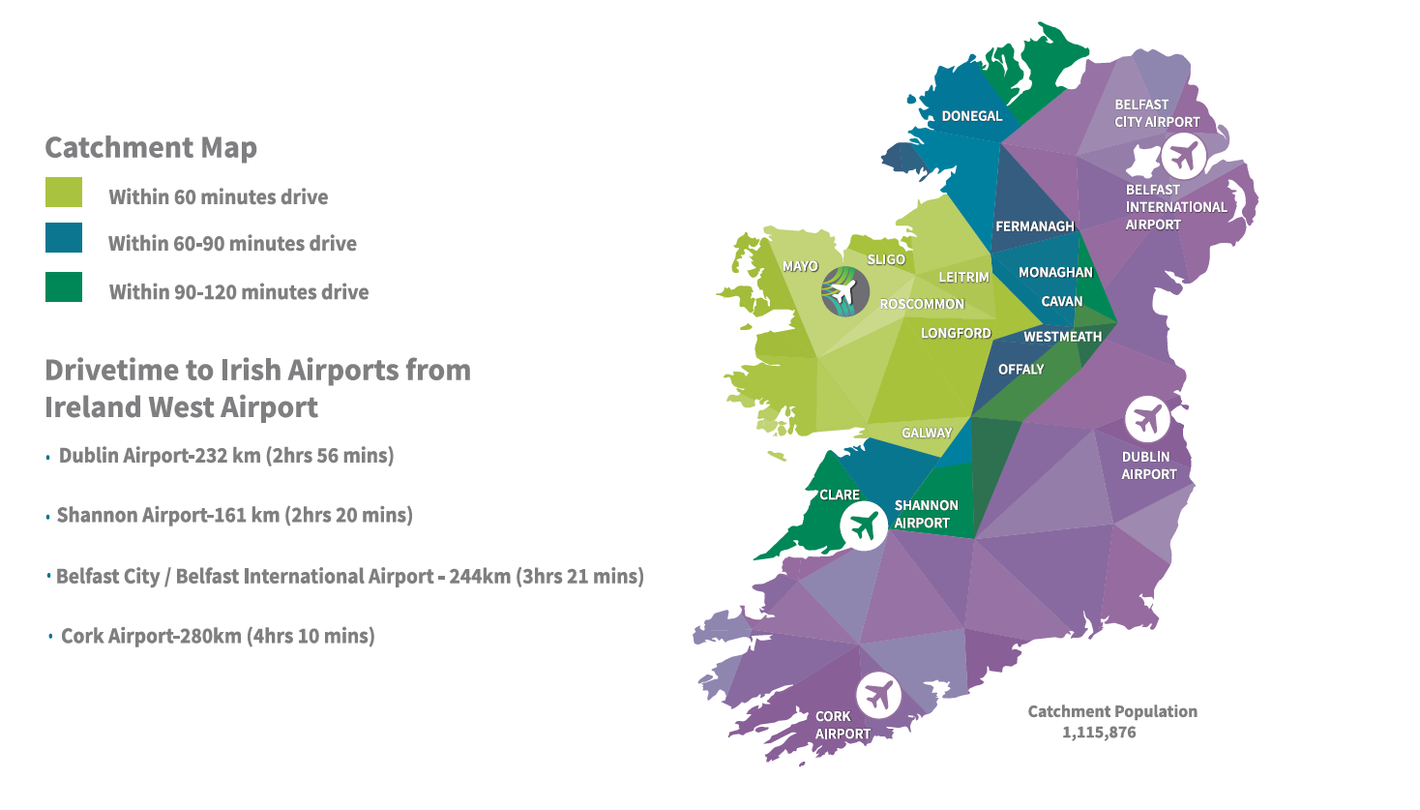


Ireland’s 4th Largest Airport
Catchment region of 1.1m people

Slide 3
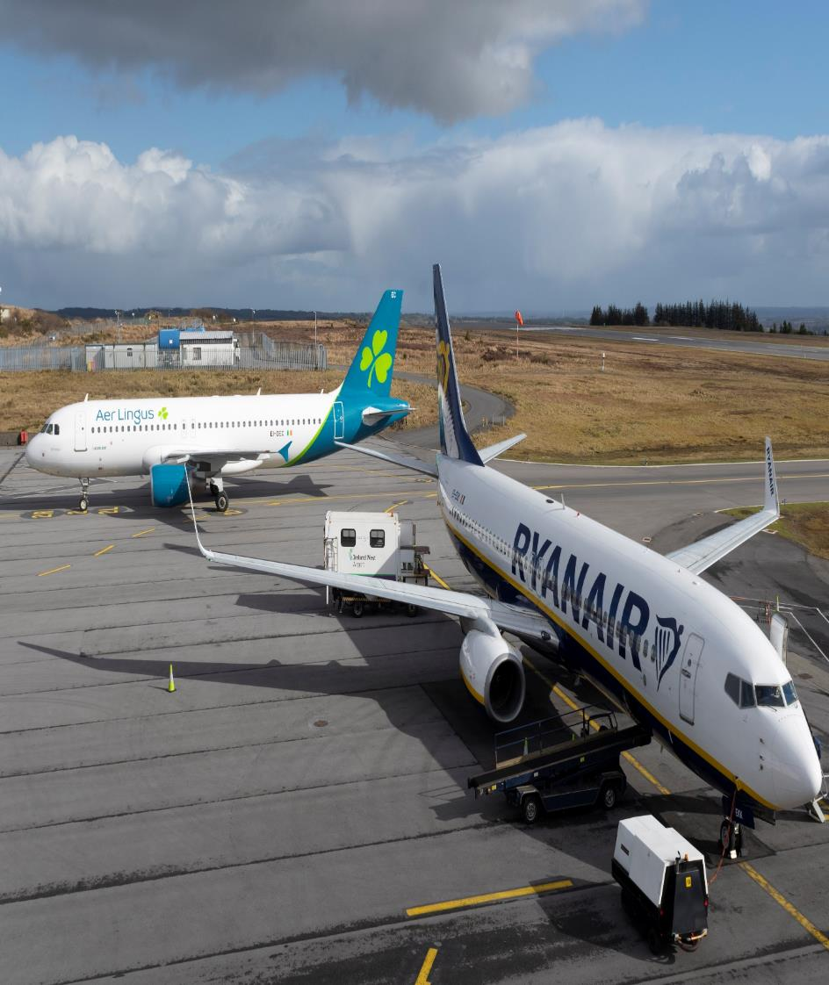

Strong Recovery in PAX
Passenger numbers forecasted to reach record levels in 2023

Slide 4
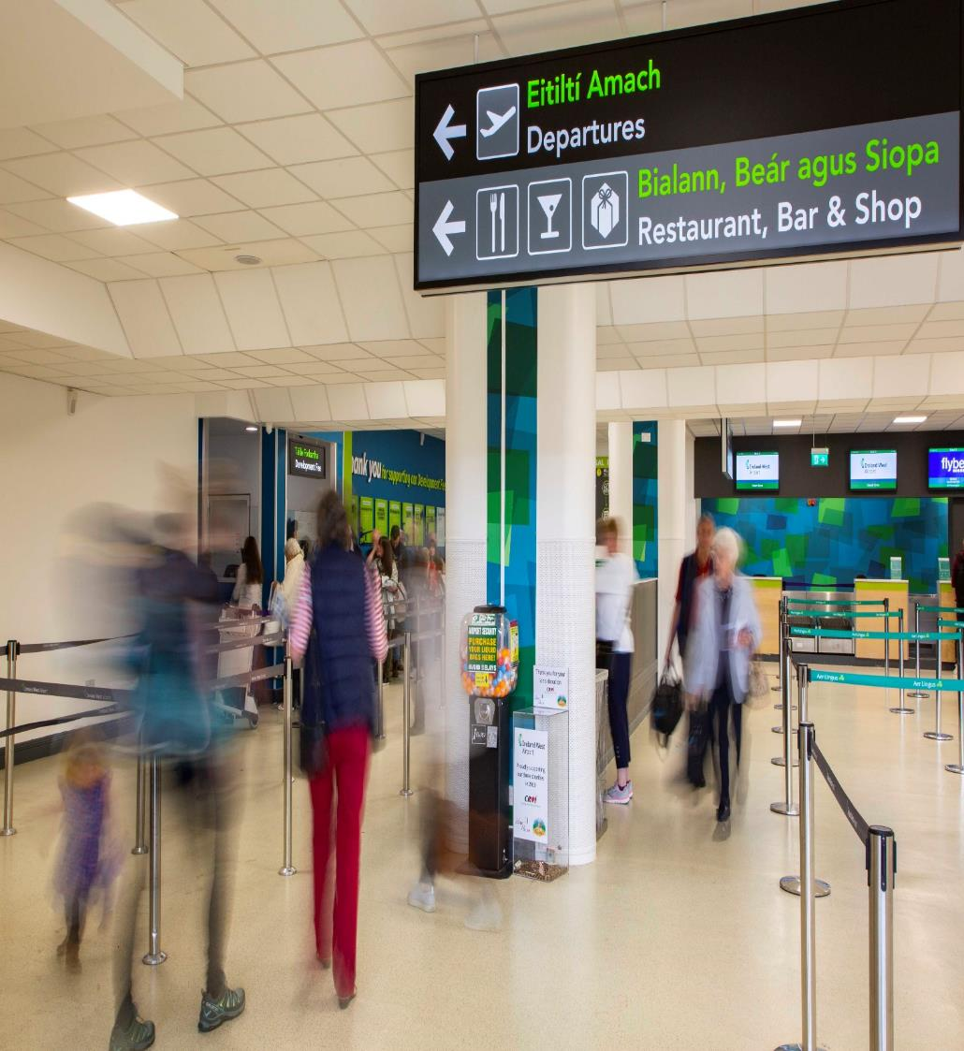


Growing Customer Base
A truly regional airport with a catchment area stretching across the entire
West, North West and Midlands region with significant potential
to stimulate traffic further from the Midlands region of the country
Donegal – 5%
Sligo – 18%
Leitrim – 7%
Longford – 4%
Mayo – 35%
Roscommon – 7%
Galway – 19%
Westmeath – 3%
Offaly – 3%
Clare – 2%

Slide 5

Route Network
19 Destinations across the UK & Europe
Scheduled Services
Charter Services
EDINBURGH
Year round
MANCHESTER
Year round
LIVERPOOL
Year round
EAST-MIDLANDS
BIRMINGHAM
LONDON (Stansted)
Year round
Year round
BRISTOL
LONDON (Luton)
Year round
Year round
COLOGNE
LONDON (Heathrow)
Seasonal
Year round
MEDJUGORJE
MILAN
Seasonal
Year round
LOURDES
Seasonal
BARCELONA
Seasonal
ALICANTE
FARO
MAJORCA
Seasonal
Seasonal
Seasonal
MALAGA
CADIZ
Seasonal
Seasonal
TENERIFE
LANZAROTE
Year Round
Year Round

Slide 6

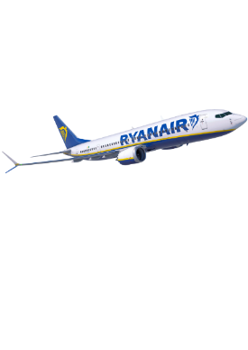
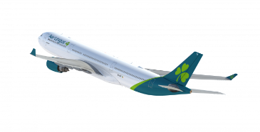
Route Expansion 2023
3 new services announced
New services
Lanzarote
Tenerife
New Service
London Heathrow
40,000+ extra seats added on services to London, Edinburgh, East Midlands, & Liverpool in 2023

Slide 7
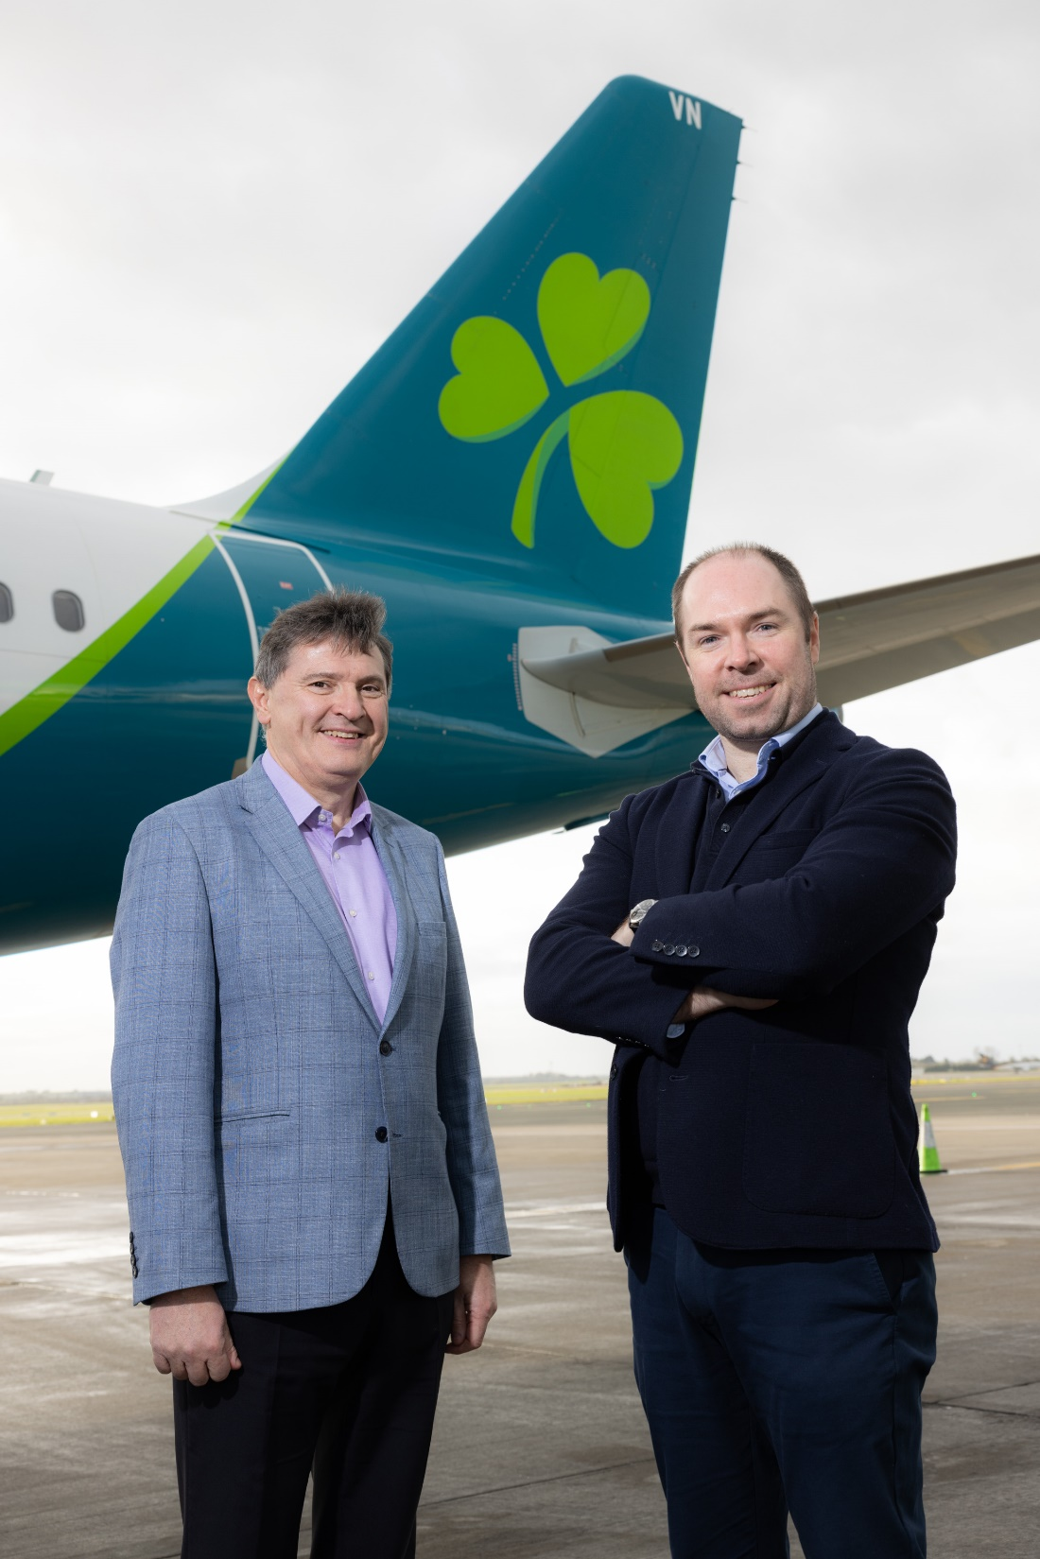
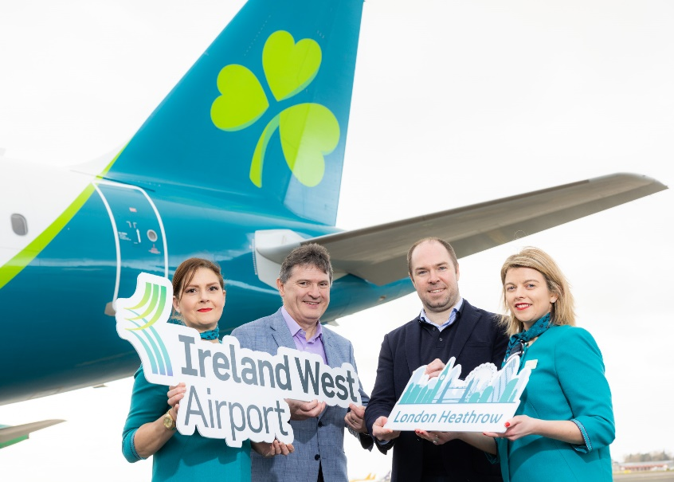
New – London Heathrow Route
New Daily service to London Heathrow starts March 26th with Aer Lingus
First time in the airports 37-year history that we will be connected to one of Europe’s major international airport hubs
Seamless connections via London Heathrow Airport to North America
Onward connectivity to 80+ destinations worldwide
Aer Lingus currently has partnerships with a network of airlines including,
Air Canada, Alaska Airlines, American Airlines, British Airways, Iberia,
JetBlue and United Airlines
British Airways codeshares on Aer Lingus services which
will offer global access from Ireland West Airport
to/from UK and London Heathrow
Major boost for businesses in the region

Slide 8




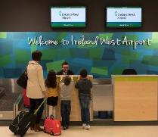

Regional Economic Driver
Over 250,000 visitors to the region annually to the West Coast of Ireland
Donegal– 12%
Destinations of inbound visitors through the airport
250,000 annual overseas visitors to the regions
€180m+ spend annually in the region
Sligo – 28%
Leitrim – 7%
Longford – 1%
€170m+ spend annually in the region
Mayo – 75%
Roscommon – 13%
Galway – 38%
Westmeath – 1%
Clare – 7%
Offaly – 1%
900,000+ annual bed nights in the region
Supporting 3,177 jobs in the region

Slide 9

Airport’s Key Regional Position
Identified by Government as a key transport infrastructure hub in NDP 2018-2027 & Project Ireland 2040 & in the NAP
Acknowledged as one of the state’s 4 main airports, and a critical driver of economic and tourism development along the WAW, Atlantic Economic Corridor
Key part of DTTAS Regional Airport’s programme and 2023 budget continues RAP funding for Regional Airports
Significant capital expenditure programme planned over next 5 years of c €30m
Key projects include safety expansion of Airport’s main parking Apron, electrical upgrade and ongoing upgrades of the Airport’s Fire, ATC and Security infrastructure

Slide 10
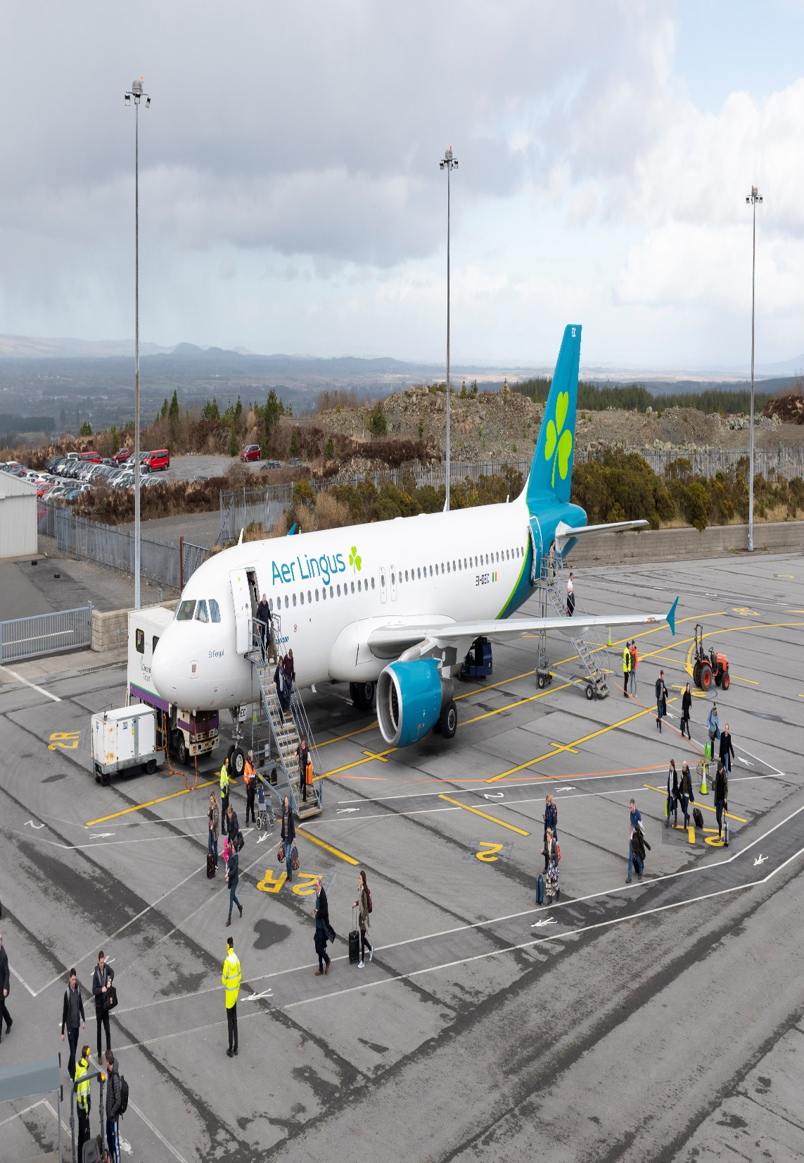
Deliverables for the region over the next 5 years
Doubling of overseas visitors
400,000 overseas visitors annually through Ireland West
Doubling of tourism
revenues
Increase in tourism revenues
by visitors through Ireland
West to €400m
Doubling of tourism revenues
Increase in tourism revenues by visitors through Ireland West to €400m by 2024
Doubling of tourism revenues
Increase in tourism revenues by visitors through Ireland West to €400m by 2024
Major increase in bed nights
Double the number of bed nights in the region annually by 2024
Major increase in bed nights
Double the number of bed nights in the region annually
Major increase in bed nights
Double the number of bed nights in the region annually by 2024

Slide 11
Summary
Forecasting record year in 2023 of 825,000 passengers
Summer 2023 will see seat capacity restored to 100% of pre covid levels as forecasts are for a stronger than expected recovery
Airport also working to attract new airlines and international routes
Significant investment in developing the facility at the airport from an infrastructural perspective
The airport is now looking at how we can further enhance the service offering through the use of digital technologies

Slide 12
Innovation Exchange Challenge
Queue Monitoring Technology
1) The airport wishes to introduce new queue monitoring technology which will assist the airport in managing traffic flow through the airport. Key metrics of a new system will be
Time spent at check in desk to departures
Time spent queuing at security screening
Time spent queuing at the Development Fee Payment Point area
Volume of people queuing at each point at any given time
Live queue times to keep passengers informed of expected time to get through security
Real time statistics identifying pinch points and peak queue times to assist staff allocation resourcing

Slide 13
Innovation Exchange Challenge
Loyalty Programme
The airport wishes to introduce a new loyalty programme to help create more loyal customers, improve customer retention, and grow a community of satisfied customers.
The airport has installed a new Retail Point of sale till system throughout all the commercial outlets at the airport.
We wish to integrate a new loyalty programme which rewards frequent customers in our catering and retail outlets
Furthermore, the airport has its own online parking platform which now accounts for over 40% of all car park bookings – the airport would like to utilise this and integrate it with a a new loyalty programme that again rewards repeat customers of the airport

Slide 14
Thank You
Donal Healy
Head of Marketing & Communications
Ireland West Airport
T: +353 94 936 8108
E: donalhealy@irelandwestairport.com

